Slide 1
Accounting Equation & FOUR Financial Statements

Slide 2

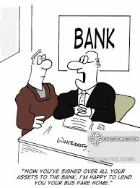
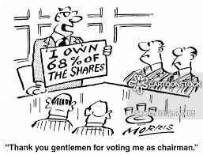
Accounting equation
A business company has two fundamental elements; what it owns (assets) and what it owes (liabilities & equity).
Creditors
Owners/Investors/ Shareholders
Assets
Assets = Liabilities + Equity

Slide 3

Assets = Liabilities + Equity(capital)
Assets
Provide future economic benefits
Stays in the business company for a long time (more than one/two year).
Some examples of Common Assets in a business organisation.
Cash
Property, plant, and equipment (Machineries, land)
Inventory
Land & Buildings
Supplies
Accounts Receivable
Prepaid Expenses
Accrued Income

Slide 4
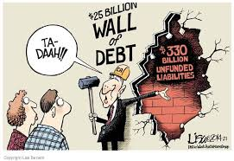
Assets = Liabilities + Equity(capital)
Liabilities
A future economic benefit will flow from the company to outside parties.
Some examples of Liabilities
Long-term loan
Accounts Payable
Accrued Expenses
Advanced Income/Unearned Income
Liability claims are to be paid before owner’s claims.

Slide 5
Assets = Liabilities + Equity(capital)
Owner’s Equity
Owner’s claim on Assets after Liabilities
Some example of Owner’s equity
Capital/Share Capital
Net Income
Drawing (money taken back by the owner from business) (mainly happens in proprietorship business).

Slide 6
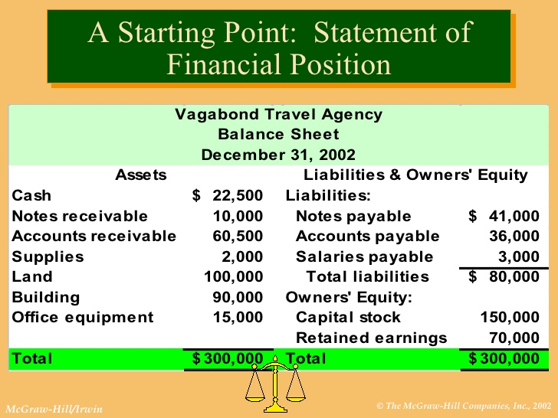
Assets, Liabilities and Equity are shown in the balance sheet or ‘Statement of Financial Position’.

Slide 7
Accrual Basis & Cash basis of Accounting
When Revenue and Expense is recorded?
Particulars | Cash Basis | Accrual Basis
Recording Revenue | When cash is received at hand | When product/service has been delivered to the customers.
Recording Expense | When cash is paid | When product/service has been received.
Example: You sold a computer in 2020 but the customer will pay you in 2021. When you would record that you earned the revenue? | in 2021, because that is when you will get the cash. | In 2020, because that is when you have delivered the computer to the customers. WE ALWAYS FOLLOW THIS ONE.

Slide 8

Income (revenue) & expenses
Income & Expenses are core activities of a business company. Income and Expense always affect balance sheet items.
Income
Gross increase in Owner’s equity that resulted from company’s core business activity.
Income increase Assets generally.
Some examples of Income (revenue)
Sales Revenue
Service Revenue
Commission Revenue (dealership business)
Interest Revenue (financial institutions)

Slide 9
Expenses
Company spends for managing core business activities
Expense always increase liability or decrease owner’s equity and decrease Assets.
Some examples of Expenses
Cost of sales
Salary
Advertising exp.
Rent
Commission exp.
Depreciation

Slide 10
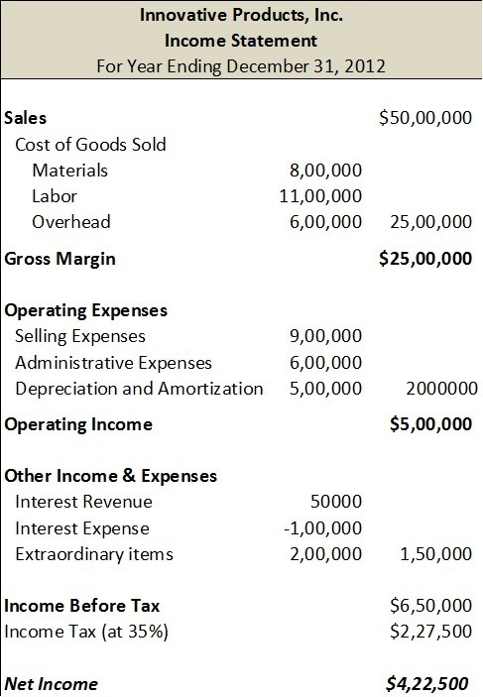
Statement of financial performance (Income statement)

Slide 11
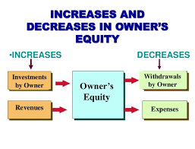
Summary

Slide 12
Extended Equation
Assets = Liabilities + (Equity-Drawings + Revenues -Expenses)

Slide 13
Financial Position:
Assets, Liabilities, and Owner’s Equity.
Balance Sheet
Financial Performance:
Revenues, Expenses
Net Profit/Net income = Total Revenues – Total Expenses
Statement of Profit or Loss/ Income Statement/ Statement of Financial Performance

Slide 14
Transaction analysis
(Economic events)
A transaction must change the financial position (Assets = Liabilities + Equity)
For example if an asset increases
Another must decrease, or
A liability must increase, or
Owner’s equity must increase.
A transaction can change the financial position in two ways
Net change
Structural change

Slide 15
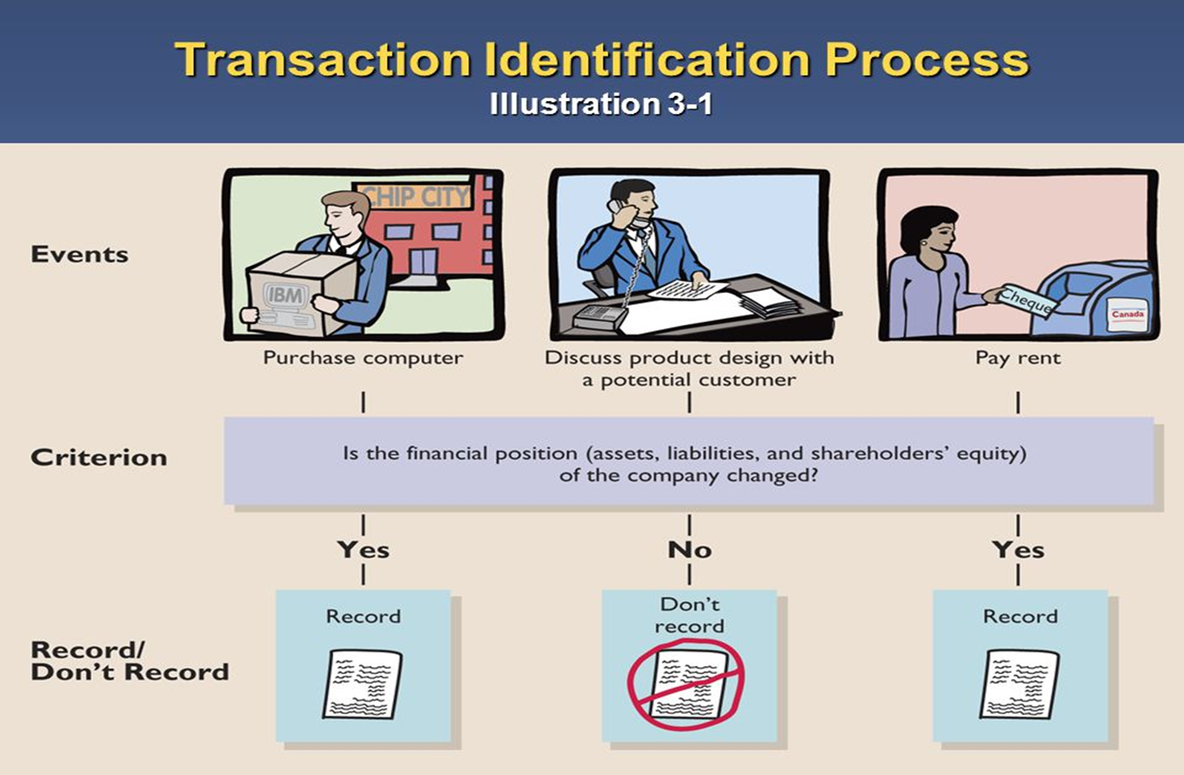

Slide 16
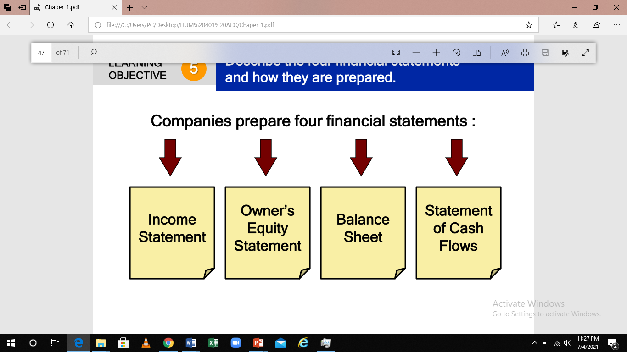
Describe the four financial statements and how they are prepared.

Slide 17
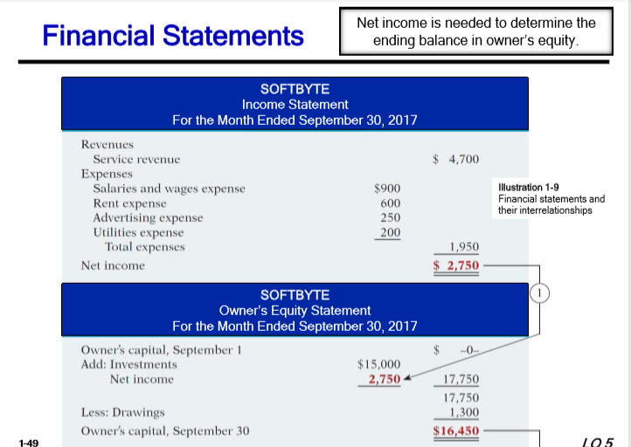

Slide 18
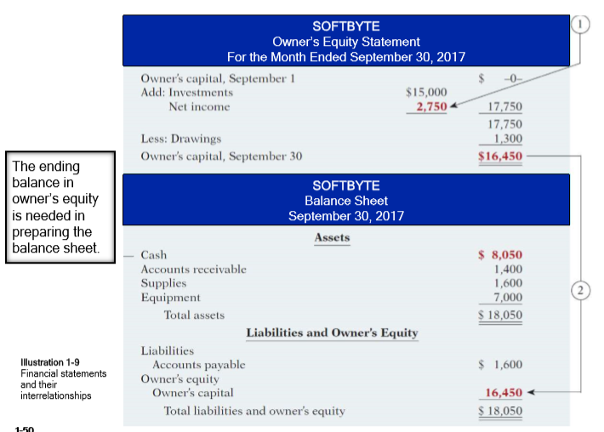

Slide 19
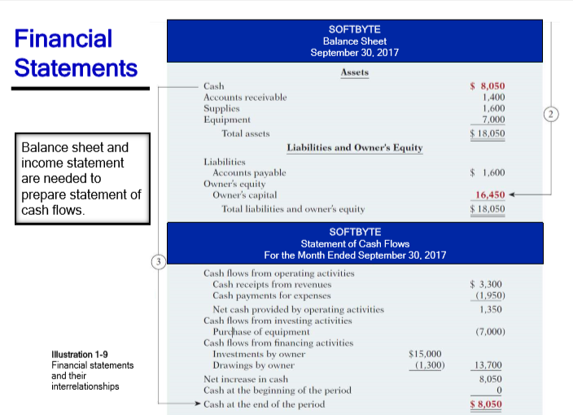

Slide 20
Income Statement
Reports the revenues and expenses for a specific period of time.
Lists revenues first, followed by expenses.
Shows net income (or net loss).
Income Statement
Does not include investment and withdrawal transactions between the owner and the business in measuring net income.

Slide 21
Owner’s equity statement
Reports the changes in owner’s equity for a specific period of time.
The time period is the same as that covered by the income statement

Slide 22
Balance Sheet
Reports the assets, liabilities, and owner's equity at a specific date.
Lists assets at the top, followed by liabilities and owner’s equity.
Total assets must equal total liabilities and owner's equity.
Is a snapshot of the company’s financial condition at a specific moment in time (usually the month-end or yearend)

Slide 23
Statement of cash flow
Information on the cash receipts and payments for a specific period of time.
Answers the following:
► Where did cash come from?
► What was cash used for?
► What was the change in the cash balance?

Slide 24
ANY QUERIES?

